Slide 1
Relational Databases and SQL
Reading: 13.1-13.2, 13.4

Slide 2
13.1: Database Basics
13.1: Database Basics
13.2: SQL
13.3: Multi-table Queries
13.4: Databases and PHP

Slide 3
Relational Databases
Relational database” A method of structuring data as tables associated to each other by shared attributes.
A table row corresponds to a unit of data called a record; a column corresponds to an attribute of that record.
relational databases typically use Structured Query Language (SQL) to define, manage, and search data

Slide 4
Database Software – Why use a database?
powerful: can search it, filter data, combine data from multiple sources
fast: can search/filter a database very quickly compared to a file
big: scale well up to very large data sizes
safe: built-in mechanisms for failure recovery (e.g. transactions)

Slide 5
Database Software – Why use a database?
multi-user: concurrency features let many users view/edit data at same time
abstract: provides layer of abstraction between stored data and app(s)
many database programs understand the same SQL commands

Slide 6

Database Software
Oracle
Microsoft SQL Server (powerful) and Microsoft Access (simple)
PostgreSQL (powerful/complex free open-source database system)
SQLite (transportable, lightweight free open-source database)
MySQL (simple free open-source database system)
Many servers run "LAMP" (Linux, Apache, MySQL, and PHP)
Wikipedia is run on PHP and MySQL
MySQL discussed in this course
Notes:
Oracle has the paid version of MySQL, Microsoft owns PostgreSQL

Slide 7
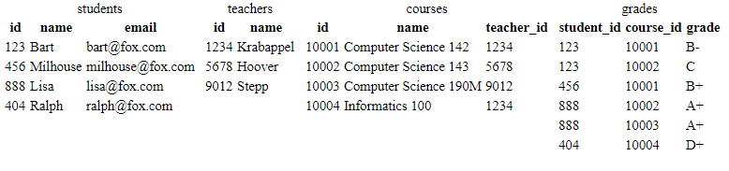
Example simpsons database
Notes:
to test queries on this database, use username homer, password d0ughnut

Slide 8
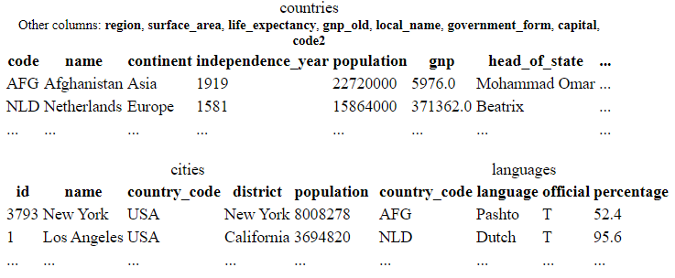
Example world database
Notes:
to test queries on this database, use username traveler, password packmybags

Slide 9
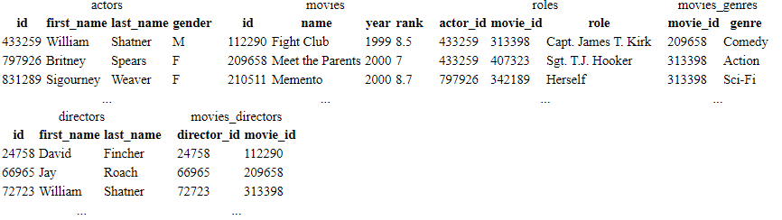
Example imdb database
Notes:
also available, imdb_small with fewer records (for testing queries)
to test queries on this database, use the username/password that we will email to you soon

Slide 10
Login to Synology mysql
Use Command in Windows 10 or Terminal in Mac/Linux
We will use SSH to securely connect to Synology server
ssh admin@lundhome.synology.me (or)
ssh admin@73.5.174.205
Enter your password for your Synology account
Prompt will change
admin@BLC_WebServer:/$
We must now change directories and run mysql
Notes:
The authenticity of host 'lundhome.synology.me (73.5.174.205)' can't be established.
ECDSA key fingerprint is SHA256:1mpZ2m/Lfh7OC8jw35G/x6t+pvZxdmywmn6MKFFhSRE.
Are you sure you want to continue connecting (yes/no)?
Warning: Permanently added 'lundhome.synology.me' (ECDSA) to the list of known hosts.

Slide 11
Login to Synology mysql
Synology NAS uses a Linux operating system
admin@BLC_WebServer:/$ ls
bin dev etc.defaults lib mnt root sbin tmp var volume1
config etc initrd lost+found proc run sys usr var.defaults
admin@BLC_WebServer:/$ cd usr/local/mariadb10/bin
admin@BLC_WebServer:/usr/local/mariadb10/bin$

Slide 12
Login to Synology mysql
admin@BLC_WebServer:/usr/local/mariadb10/bin$
Run mysql by typing: ./mysql -u student –p
Password: sqldb4Life#
You made it to mysql!

Slide 13
Ready to use Synology mysql
Welcome to the MariaDB monitor. Commands end with ; or \g.
Your MariaDB connection id is 35
Server version: 10.3.24-MariaDB Source distribution
Copyright (c) 2000, 2018, Oracle, MariaDB Corporation Ab and others.
Type 'help;' or '\h' for help. Type '\c' to clear the current input statement.
MariaDB [(none)]>

Slide 14
13.2: SQL Basics
Structured Query Language (SQL): a language for searching and updating a database
a standard syntax that is used by all database software (with minor incompatibilities)
generally, case-insensitive
a declarative language: describes what data you are seeking, not exactly how to find it
SELECT name FROM cities WHERE id = 17;
INSERT INTO countries VALUES ('SLD', 'ENG', 'T', 100.0);

Slide 15
Issuing SQL commands directly in MySQL
SHOW DATABASES;
USE database;
SHOW TABLES;
mysql> USE world; Database changed
mysql> SHOW TABLES;
+-----------+
| cities |
| countries |
| languages |
+-----------+
3 rows in set (0.00 sec)
Notes:
Web Programming Step by Step, 2nd Edition Lecture 13: Relational Databases and SQL (webstepbook.com)

Slide 16
The SQL SELECT statement
SELECT column(s) FROM table; // general form
SELECT name, code FROM countries;
name code
+---------------+--------+
| China | CHN |
| United States | USA |
| Indonesia | IND |
| Brazil | BRA |
| Pakistan | PAK |
+---------------|--------+
5 rows in set (0.12 sec)
Notes:
Web Programming Step by Step, 2nd Edition Lecture 13: Relational Databases and SQL (webstepbook.com)

Slide 17
The SQL SELECT statement
the SELECT statement searches a database and returns a set of results
the column name(s) written after SELECT filter which parts of the rows are returned
table and column names are case-sensitive
SELECT * FROM table; keeps all columns
Notes:
Web Programming Step by Step, 2nd Edition Lecture 13: Relational Databases and SQL (webstepbook.com)

Slide 18
The DISTINCT modifier
SELECT DISTINCT column(s) FROM table;
SELECT language SELECT DISTINCT language
FROM languages; FROM languages;
language
Dutch
English
English
Papiamento
Spanish
Spanish
Spanish
...
language
Dutch
English
Papiamento
Spanish
...
Notes:
Web Programming Step by Step, 2nd Edition Lecture 13: Relational Databases and SQL (webstepbook.com)

Slide 19
The WHERE clause
SELECT column(s) FROM table WHERE condition(s);
SELECT name, population FROM cities
WHERE country_code = "FSM";
+---------+------------+
| name | population |
+---------+------------+
| Weno | 22000 |
| Palikir | 8600 |
+---------+------------+
2 rows in set (0.073 sec)
Notes:
Web Programming Step by Step, 2nd Edition Lecture 13: Relational Databases and SQL (webstepbook.com)

Slide 20
The WHERE clause
WHERE clause filters out rows based on their columns' data values
in large databases, it's critical to use a WHERE clause to reduce the result set size
suggestion: when trying to write a query, think of the FROM part first, then the WHERE part, and lastly the SELECT part
Notes:
Web Programming Step by Step, 2nd Edition Lecture 13: Relational Databases and SQL (webstepbook.com)

Slide 21
More about the WHERE clause
WHERE column operator value(s)
SELECT name, gnp FROM countries WHERE gnp > 2000000;
+---------------+------------+
| name | gnp |
+---------------+------------+
| Japan | 3787042.00 |
| Germany | 2133367.00 |
| United States | 8510700.00 |
+---------------+------------+
3 rows in set (0.002 sec)
Notes:
Web Programming Step by Step, 2nd Edition Lecture 13: Relational Databases and SQL (webstepbook.com)

Slide 22
More about the WHERE clause
the WHERE portion of a SELECT statement can use the following operators:
=, >, >=, <, <=
<> : not equal
BETWEEN min AND max
LIKE pattern
IN (value, value, ..., value)
Notes:
Web Programming Step by Step, 2nd Edition Lecture 13: Relational Databases and SQL (webstepbook.com)

Slide 23
Multiple WHERE clauses (AND, OR)
SELECT * FROM cities WHERE country_code = 'USA’
AND population >= 2000000;
+------+-------------+--------------+------------+------------+
| id | name | country_code | district | population |
+------+-------------+--------------+------------+------------+
| 3793 | New York | USA | New York | 8008278 |
| 3794 | Los Angeles | USA | California | 3694820 |
| 3795 | Chicago | USA | Illinois | 2896016 |
+------+-------------+--------------+------------+------------+
3 rows in set (0.007 sec)
multiple WHERE conditions can be combined using AND and OR
Notes:
Web Programming Step by Step, 2nd Edition Lecture 13: Relational Databases and SQL (webstepbook.com)

Slide 24
Approximate matches: LIKE
WHERE column LIKE pattern
SELECT code, name, population FROM countries
WHERE name LIKE 'United%';
+------+--------------------------------------+------------+
| code | name | population |
+------+--------------------------------------+------------+
| ARE | United Arab Emirates | 2441000 |
| GBR | United Kingdom | 59623400 |
| USA | United States | 278357000 |
| UMI | United States Minor Outlying Islands | 0 |
+------+--------------------------------------+------------+
Notes:
Web Programming Step by Step, 2nd Edition Lecture 13: Relational Databases and SQL (webstepbook.com)

Slide 25
Approximate matches: LIKE
WHERE column LIKE pattern
LIKE 'text%' searches for text that starts with a given prefix
LIKE '%text' searches for text that ends with a given suffix
LIKE '%text%' searches for text that contains a given substring
Notes:
Web Programming Step by Step, 2nd Edition Lecture 13: Relational Databases and SQL (webstepbook.com)

Slide 26
Sorting by a column: ORDER BY
ORDER BY column(s)
Can write ASC or DESC to sort in ascending (default) or descending order:
SELECT * FROM countries ORDER BY population DESC;
Can specify multiple orderings in decreasing order of significance:
SELECT * FROM countries ORDER BY population DESC, gnp;
See also: GROUP BY
Notes:
Web Programming Step by Step, 2nd Edition Lecture 13: Relational Databases and SQL (webstepbook.com)

Slide 27
Sorting by a column: ORDER BY
ORDER BY column(s)
SELECT code, name, population FROM countries
WHERE name LIKE 'United%' ORDER BY population;
+------+--------------------------------------+------------+
| code | name | population |
+------+--------------------------------------+------------+
| UMI | United States Minor Outlying Islands | 0 |
| ARE | United Arab Emirates | 2441000 |
| GBR | United Kingdom | 59623400 |
| USA | United States | 278357000 |
+------+--------------------------------------+------------+
Notes:
Web Programming Step by Step, 2nd Edition Lecture 13: Relational Databases and SQL (webstepbook.com)

Slide 28
Limiting rows: LIMIT
LIMIT number
SELECT name FROM cities WHERE name LIKE 'K%' LIMIT 5;
+--------------------+
| name |
+--------------------+
| Kabul |
| Khulna |
| Kingston upon Hull |
| Koudougou |
| Kafr al-Dawwar |
+--------------------+
can be used to get the top-N of a given category (ORDER BY and LIMIT)
also useful as a sanity check to make sure your query doesn't return 10⁷ rows
Notes:
Web Programming Step by Step, 2nd Edition Lecture 13: Relational Databases and SQL (webstepbook.com)

Slide 29
13.4 – Databases and PHP
Notes:
Web Programming Step by Step, 2nd Edition Lecture 13: Relational Databases and SQL (webstepbook.com)

Slide 30
Querying a Database in PHP with PDO
PHP Data Object documentation
PDO database library allows you to connect to many different database programs
replaces older, less versatile functions like mysql_connect
PDO object's query function returns rows that match a query
Notes:
Web Programming Step by Step, 2nd Edition Lecture 13: Relational Databases and SQL (webstepbook.com)

Slide 31
Querying a Database in PHP with PDO
$name = new PDO("dbprogram:dbname=database;host=server", username, password);
$name->query("SQL query");
# connect to world database on local server
$db = new PDO("mysql:dbname=world;host=localhost", "traveler", "packmybags");
$db->query("SELECT * FROM countries WHERE population > 100000000;");
Notes:
Web Programming Step by Step, 2nd Edition Lecture 13: Relational Databases and SQL (webstepbook.com)

Slide 32
Result rows: query
$db = new PDO("mysql:dbname=world;host=localhost", "traveler", "packmybags");
$rows = $db->query("SELECT * FROM countries WHERE population > 100000000;");
foreach ($rows as $row) {
do something with $row;
}
Notes:
Web Programming Step by Step, 2nd Edition Lecture 13: Relational Databases and SQL (webstepbook.com)

Slide 33
Result rows: query
foreach ($rows as $row) {
do something with $row;
}
query returns all result rows
each row is an associative array of [column name -> value]
example: $row["population"] gives the value of the population column
Notes:
Web Programming Step by Step, 2nd Edition Lecture 13: Relational Databases and SQL (webstepbook.com)

Slide 34
A complete example
$db = new PDO("mysql:dbname=imdb_small", "jessica", "guinness");
$rows = $db->query("SELECT * FROM actors WHERE last_name LIKE 'Del%'");
foreach ($rows as $row) {
?>
<li> First name: <?= $row["first_name"] ?>,
Last name: <?= $row["last_name"] ?> </li>
<?php
}
First name: Benicio, Last name: Del Toro
First name: Michael, Last name: Delano
...
Notes:
Web Programming Step by Step, 2nd Edition Lecture 13: Relational Databases and SQL (webstepbook.com)

Slide 35
PDO object methods
name description
query performs a SQL SELECT query on the database
exec performs a SQL query that modifies the database (INSERT, DELETE, UPDATE, etc.)
getAttribute,
setAttribute get/set various DB connection properties
quote encodes a value for use within a query
Notes:
Web Programming Step by Step, 2nd Edition Lecture 13: Relational Databases and SQL (webstepbook.com)

Slide 36
Including variables in a query
# get query parameter for name of movie
$title = $_GET["movietitle"];
$rows = $db->query("SELECT year FROM movies
WHERE name = '$title'");
you should not directly include variables or query parameters in a query
they might contain illegal characters or SQL syntax to mess up the query
Notes:
Web Programming Step by Step, 2nd Edition Lecture 13: Relational Databases and SQL (webstepbook.com)

Slide 37
Quoting variables
# get query parameter for name of movie
$title = $_GET["movietitle"];
$title = $db->quote($title);
$rows = $db->query("SELECT year FROM movies
WHERE name = $title");
call PDO's quote method on any variable to be inserted
quote escapes any illegal chars and surrounds the value with ' quotes
prevents bugs and security problems in queries containing user input
Notes:
Web Programming Step by Step, 2nd Edition Lecture 13: Relational Databases and SQL (webstepbook.com)

Slide 38
Database/query errors
$db = new PDO("mysql:dbname=imdb_small", "jessica", "guinness");
$rows = $db->query("SEEELECT * FROM movies
WHERE year = 2000"); # FALSE
database commands can often fail (invalid query; server not responding; etc.)
normally, PDO commands fail silently by returning FALSE or NULL
but this makes it hard to notice and handle problems
Notes:
Web Programming Step by Step, 2nd Edition Lecture 13: Relational Databases and SQL (webstepbook.com)

Slide 39
Exceptions for errors
$db = new PDO("mysql:dbname=imdb_small", "jessica", "guinness");
$db->setAttribute(PDO::ATTR_ERRMODE, PDO::ERRMODE_EXCEPTION);
$rows = $db->query("SEEELECT * FROM movies WHERE year = 2000"); # kaboom!
Using setAttribute, you can tell PDO to throw (generate) a PDOException when an error occurs
The exceptions will appear as error messages on the page output
You can catch the exception to gracefully handle the error
Notes:
Web Programming Step by Step, 2nd Edition Lecture 13: Relational Databases and SQL (webstepbook.com)

Slide 40
Catching an exception
try {
statement(s);
} catch (ExceptionType $name) {
code to handle the error;
}
A try/catch statement attempts to run some code, but if it throws a given kind of exception, the program jumps to the catch block and runs that code to handle the error
Notes:
Web Programming Step by Step, 2nd Edition Lecture 13: Relational Databases and SQL (webstepbook.com)

Slide 41
Example with error checking
try {
$db = new PDO("mysql:dbname=imdb_small", "jessica", "guinness");
$db->setAttribute(PDO::ATTR_ERRMODE, PDO::ERRMODE_EXCEPTION);
$rows = $db->query("SEEELECT * FROM movies WHERE year = 2000");
foreach ($rows as row) { ... }
} catch (PDOException $ex) {
?>
<p>Sorry, a database error occurred. Please try again later.</p>
<p>(Error details: <?= $ex->getMessage() ?>)</p>
<?php
}
Notes:
Web Programming Step by Step, 2nd Edition Lecture 13: Relational Databases and SQL (webstepbook.com)

Slide 42
PDOStatement methods
The $rows returned by PDO's query method is technically not an array but an object of type PDOStatement. Here are its methods:
columnCount() number of columns in the results
fetch() return the next row from the results
fetchColumn(number) return the next column from the results
rowCount() number of rows returned by the query
if ($db->rowCount() > 0) {
$first_row = $db->fetch();
...
}
Notes:
Web Programming Step by Step, 2nd Edition Lecture 13: Relational Databases and SQL (webstepbook.com)

